Slide 1
Turning Experimental Procedures into Machine-Readable Recipes
William Spitzer, Menghsuan Sam, Iveel Tsogsuren

Slide 2
Process
Experimental Label Tagger
Separate Steps
Group by Label
Order Steps
Recipe Level Dependency Parser
Generate Recipe
Raw Text
Order Ind. Step
Step Level Dependency Parser

Slide 3
Experimental Label Tagger
EL Tags: A-Action
I-Ingredient
E-Equipment
PR-Product
P-Property
R-Reference
N-None
Raw Text
Words (separated into sent.):
...W_{t-2},W_{t-1},W_{t},W_{t+1},W_{t+2},...
Features
-Unigrams
-Bigrams
-Trigrams
-Digits
-PT
-ELT
Experimental Label Tagger
EL Tagged Words (sentence level)
...(W_{t},ELT_{t})...
NLTK POS tags:
...PT_{t-2},PT_{t-1},PT_{t},PT_{t+1},PT_{t+2},...
EL tags:
...ELT_{t-2},ELT_{t-1},ELT_{t}

Slide 4
Experimental Label Grouper and Step Sorter
Rule Based Grouper
1) Group words with same label together
ex (are, A), (calculated, A)
-> (are calculated, A)
Special cases (skip 1) are also grouped together
ex (are, A), (then, N), (calculated, A)
->(are (+) calculated, A)
2) Discards ‘N’ tagged words
3) Separates out Actions
Each step contains exactly 1 Action
4) Extracts Ordering keywords
['first', 'second', 'third', 'fourth', 'fifth', 'next', 'then',
'after', 'before', 'last', 'lastly', 'finally']
Grouped Words (step level)
…(W...W_{t},ELT_{t})...
EL Tagged Words (sentence level)
...(W_{t},ELT_{t})...
Order Keywords (recipe level)
…(O_{t})...

Slide 5
Dependency Parser for Grouped Words
Features: -Unigram
-Bigram
-Trigram
-EL tags
Transition Based Dependency Parser
(uses SHIFT, LEFT, RIGHT moves to generate arcs)
Grouped Words (step level)
…(W...W_{t},ELT_{t})...
List of Arcs (heads) (step level)
…(H_{t})...

Slide 6
Dependency Parser for Recipe Steps
Features: -Unigram
-Bigram
-Trigram
Transition Based Dependency Parser
(uses SHIFT, LEFT, RIGHT moves to generate arcs)
Order Keywords (recipe level)
…(O_{t})...
List of Arcs (heads) (recipe level)
…(H_{t})...

Slide 7
Generating Complete Recipe
Step Level: Use step level Arcs to link Properties to Ingredients, Equipments, Products, References, Actions, and link I/E/P/R to Actions.
Recipe Level: Order the steps based on the recipe level arcs
List of Arcs (heads) (step level)
…(H_{t})...
Complete Recipe!
A
List of Arcs (heads) (recipe level)
…(H_{t})...
I
E
R
PR
P
P
P
P
P

Slide 8
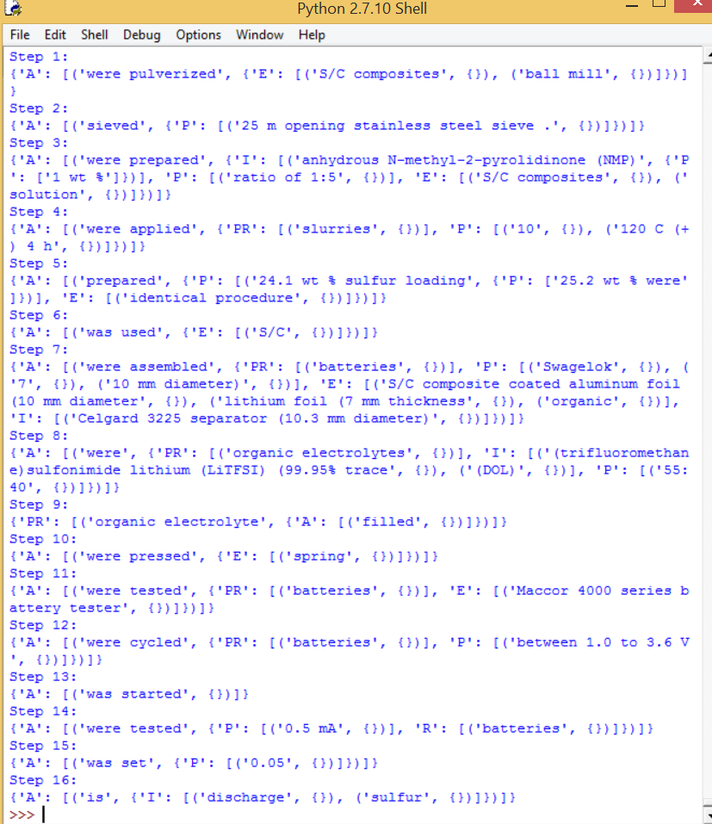
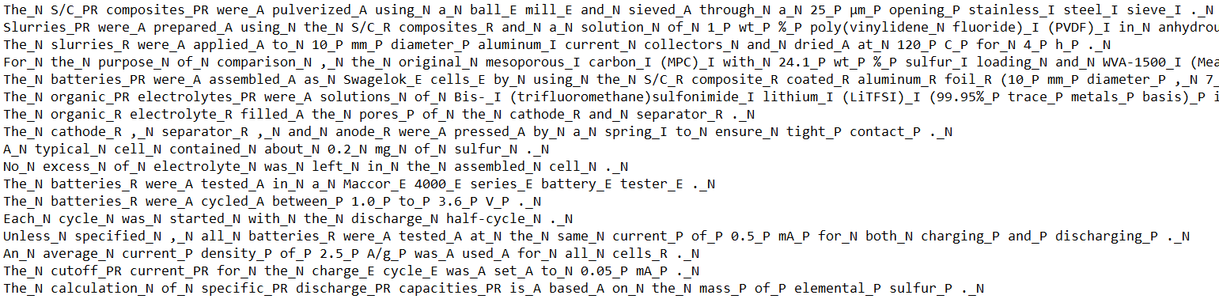

Sample Input/Output

